Slide 1
Project Update – Week 6
Tora Gao, Zheng Shi, Leon Zhang

Slide 2
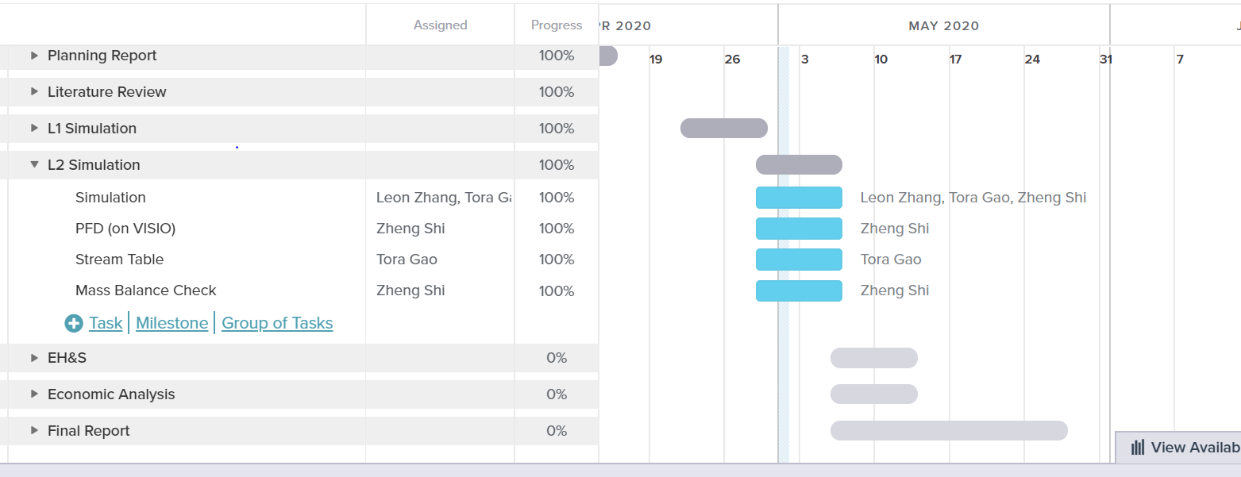
Gantt Chart
Notes:
https://prod.teamgantt.com/gantt/schedule/?ids=2115888#&ids=2115888&user=&custom=&company=&hide_completed=false&date_filter=&color_filter=

Slide 3
Tasks Completed
L2 simulation
L2 assignment document
Sizing of most equipment
Heuristics mostly done

Slide 4
Unexpected hurdles and Potential Solutions
Unexpected Hurdles:
Ammonia storage tanks and sizing them
How much will we need to store at a given time? What are the ASME guidelines? Where can we get volume/pricing info for these?
Potential Solutions:
Do more research

Slide 5
Short-Term and Long-Term Plans
Short-Term
CAPCOST/capital cost estimates
Operating cost (manufacturing, utility, etc.)
Long-Term
Final report components (economics, ES&H, etc.)

